Slide 1



WAF + ML for Cyber Attack Detection
Machine Learning-based Network Intrusion Detection System (NIDS) on AWS
Speaker: Lê Hoàng Gia Đại
ID: 2280618445
Team: AWS G3
first cloud journey

Slide 2
Agenda
Combining AWS WAF with Machine Learning for Cyber Attack Detection on AWS
AWS WAF: Capabilities, strengths, and limitations.
Why signature-based protection is not enough for modern attacks.
Introduction to NIDS and behavior-based detection using Machine Learning.
Building and training a Machine Learning-based NIDS using the CSE-CIC-IDS2018 dataset.
Developing a real-time dashboard for attack monitoring and visualization.
Correlating NIDS predictions with AWS WAF events for enhanced threat detection.
System architecture, deployment on AWS, and operational workflow.
Demo, lessons learned, challenges, and future improvements.
first cloud journey
1

Slide 3
WAF
first cloud journey
2

Slide 4
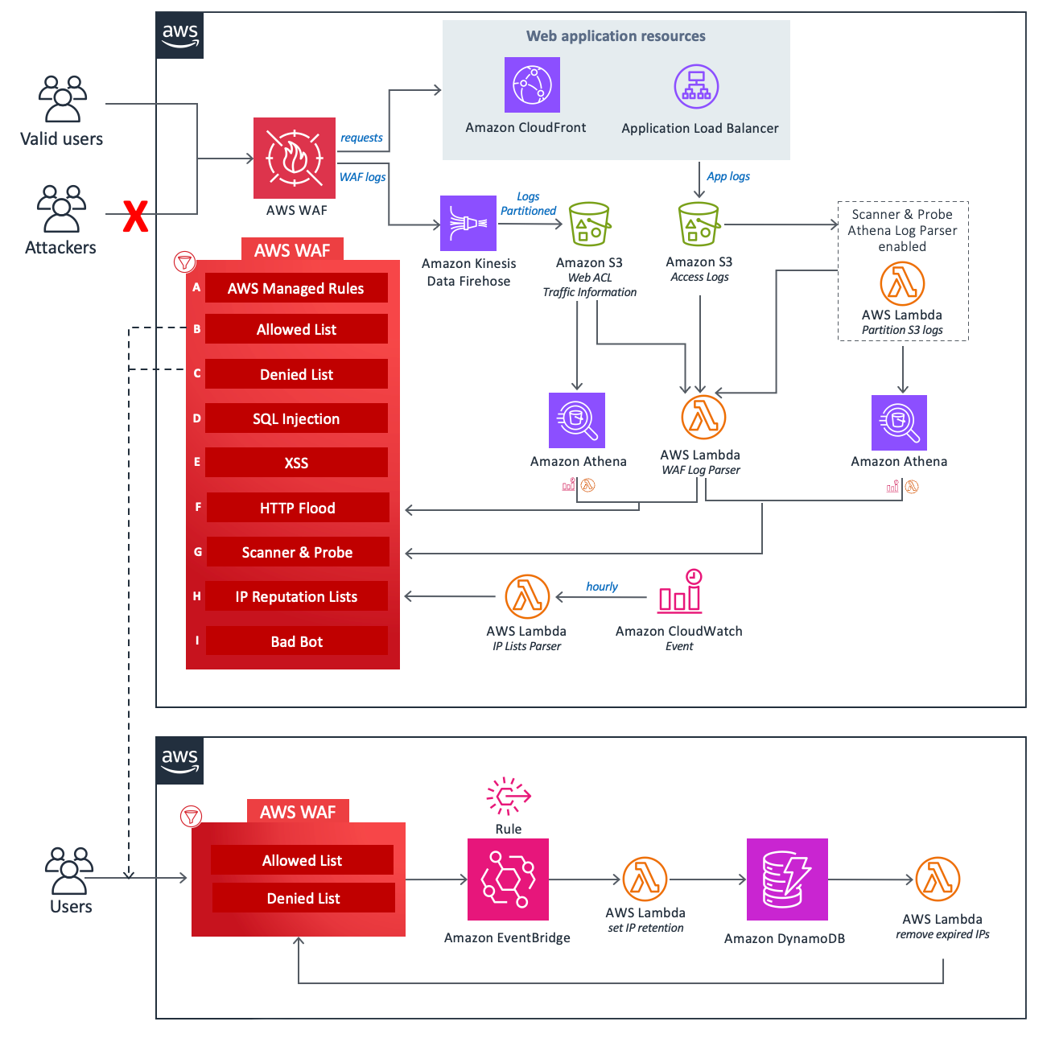

AWS WAF - Web Application Protection
AWS WAF (Web Application Firewall):
Is a web application firewall service from Amazon Web Services that helps protect websites, APIs, and applications from common web exploits at the HTTP/HTTPS layer, such as SQL Injection, XSS, bot traffic, brute force, and anomalous requests.
Key Features:
Protects CloudFront, Application Load Balancer, API Gateway, and Cognito.
Allows the creation of Web ACLs and rules to Allow / Block / Count / CAPTCHA.
Supports AWS Managed Rules and custom rules.
Features rate limiting to mitigate brute force, scraping, and anomalous traffic.
Integrates logging, monitoring, and centralized operations on AWS.
Benefits:
Enhances security for web applications and APIs.
Reduces the risk of common vulnerability exploits.
Fast deployment and easy integration with AWS infrastructure.
Serves as an additional layer of defense alongside secure coding and patching.
first cloud journey
3

Slide 5
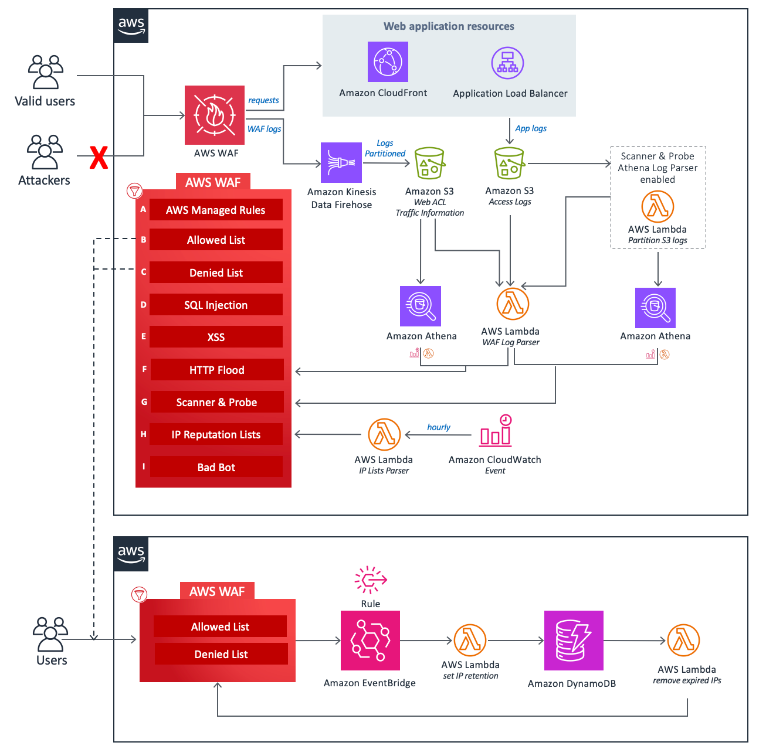
AWS WAF - The Limitations of Traditional WAF
Why Rule-Based Detection Is No Longer Enough?
Core Mechanism: Primarily relies on predefined rules (Rule-Based Detection).
The Strength: Highly effective against known attack patterns.
The Vulnerabilities: Struggles significantly against:
Novel / Zero-day attack techniques
Hybrid & spoofing attacks
Unprecedented anomalous behaviors
Moving Beyond Predefined Rules
The Challenge:
"Is it possible to build a system capable of learning from network data to detect threats without having to predefine every single rule?"
The Solution: WAF + Machine Learning NIDS.
The Goal: Proactive defense and automated adaptation to new threats.
first cloud journey
4

Slide 6
Introduction to NIDS
first cloud journey
5

Slide 7

Network Intrusion Detection System (NIDS)
Network Intrusion Detection System (NIDS)
NIDS (Network Intrusion Detection System) is a system designed to monitor and detect cyberattacks targeting the network.
Objective: Detect anomalous behaviors, attacks, and unauthorized access to the system.
The Internet
NIDS
Core Functions of NIDS:
Traffic Monitoring: Network, Web, and HTTP/HTTPS traffic.
Behavioral Analysis: Signature matching or anomaly detection.
Detection & Alerting: Sends real-time alerts upon threat detection.
Logging & Response: Records incident details for further analysis.
Integration Capabilities: Seamlessly integrates with Firewalls, SIEMs, or other IDS solutions.
Firewall
Trusted Network
NIDS management
first cloud journey
6

Slide 8

ML & AWS Applications in Cybersecurity
Machine Learning:
Capable of learning from real-world network behaviors.
Detects novel attack patterns.
Automatically analyzes massive volumes of network data.
Continuously adapts to rapidly changing threats.
Amazon Web Services:
Infrastructure platform built to meet stringent security requirements.
Service model reduces the burden of physical security management.
Ability to scale security on-demand based on system needs.
first cloud journey
7

Slide 9
Building and training a Machine Learning-based NIDS
first cloud journey
8

Slide 10
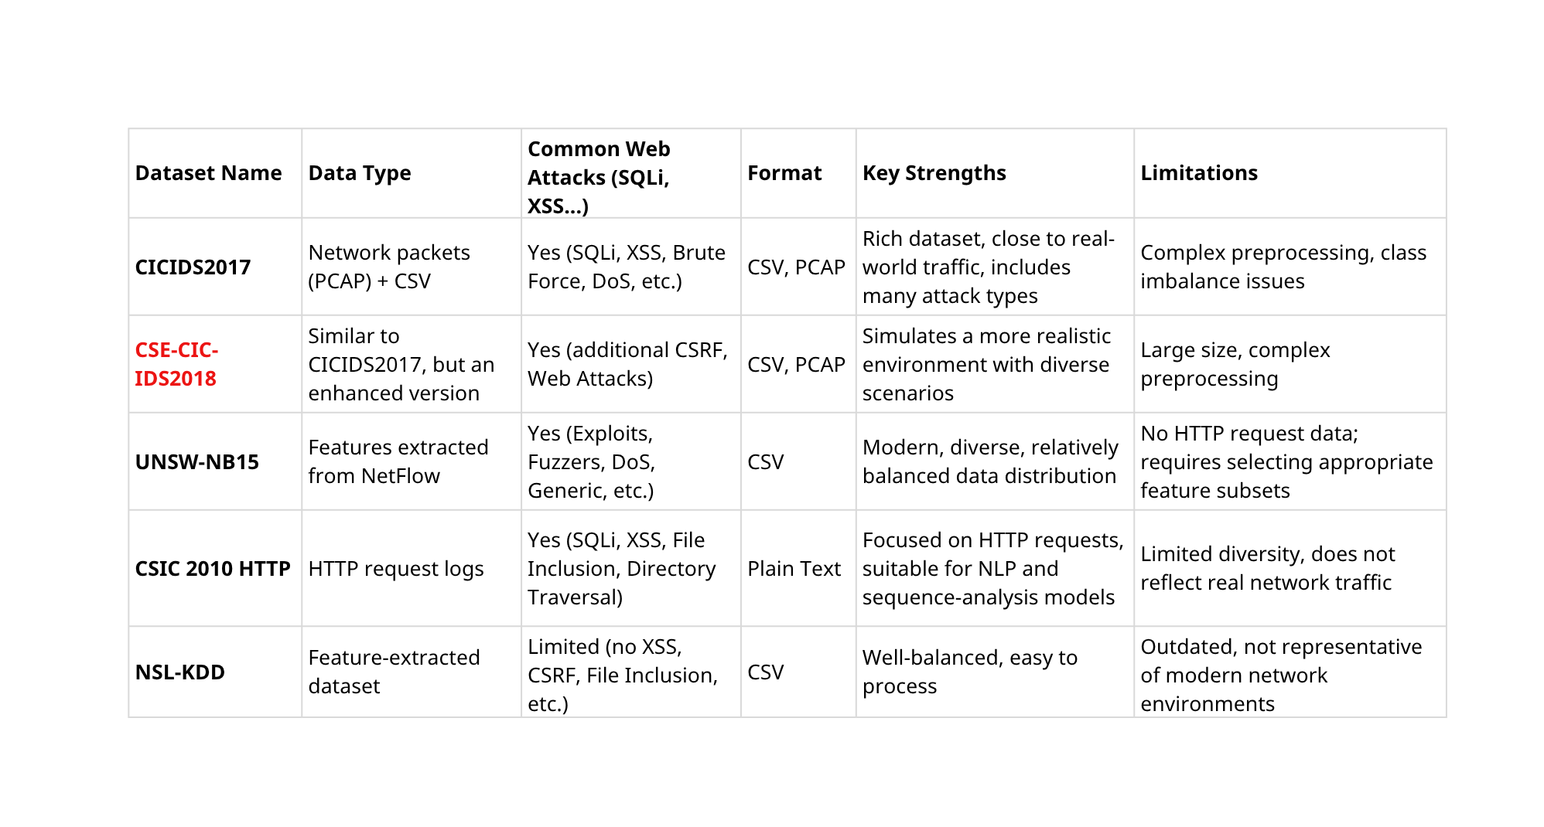
Comparative Study of Datasets
first cloud journey
9

Slide 11
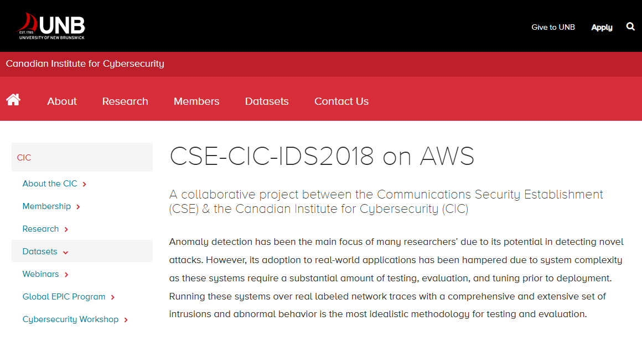
Selected Dataset
CSE-CIC-IDS2018 Dataset
CSE-CIC-IDS2018 on AWS was developed through a collaboration between the Communications Security Establishment (CSE) and the Canadian Institute for Cybersecurity (CIC) at the University of New Brunswick (UNB), Canada.
Source:
University of New Brunswick (UNB) Dataset
https://www.unb.ca/cic/datasets/ids-2018.html
Dataset Labels: ['Benign', 'Bot', 'DoS attacks-SlowHTTPTest', 'DoS attacks-Hulk', 'Label', 'Brute Force -Web', 'Brute Force -XSS', 'SQL Injection', 'DoS attacks-GoldenEye', 'DoS attacks-Slowloris', 'FTP-BruteForce','SSH-Bruteforce', 'DDOS attack-LOIC-UDP', 'DDOS attack-HOIC']
first cloud journey
10

Slide 12
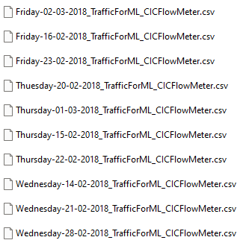
Data Preprocessing Steps
Explore and process the entire dataset from multiple CSV files, then merge all .csv files into a unified dataset.
Data cleaning:
Remove records with incorrect or corrupted Label values.
Handle missing values and invalid values such as negative numbers, NaN, or ±∞ (infinity).
Remove unnecessary columns and perform data validation checks.
Split the dataset into training and testing sets while maintaining class balance.
Remove negative, NaN, and ±∞ values
Remove unnecessary columns
Step 4: Balance the classes (labels)
Step 1: Explore the dataset
Step 2: Merge CSV files
Step 3: Clean the data
Remove invalid labels
first cloud journey
11

Slide 13
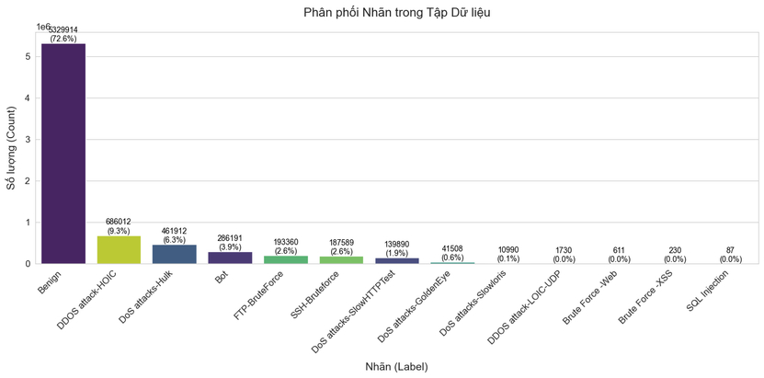
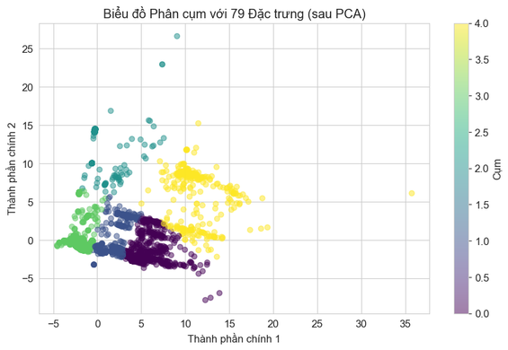
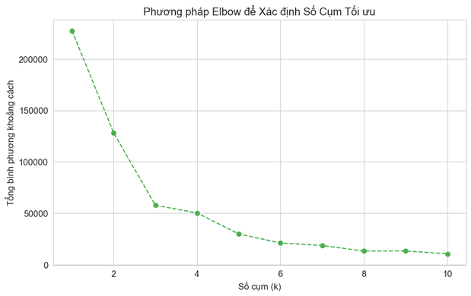
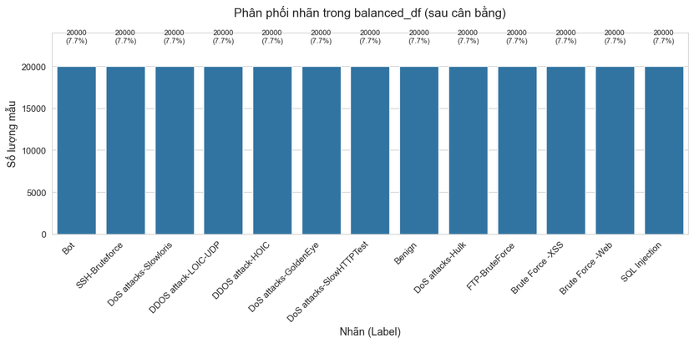
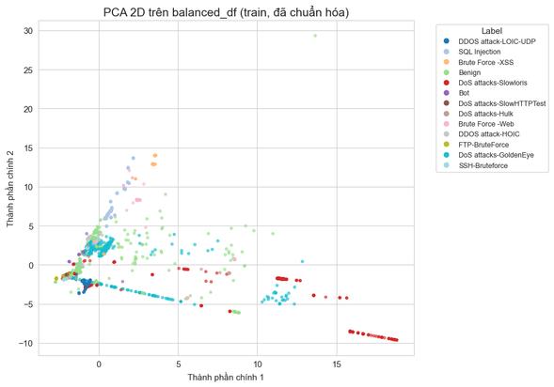
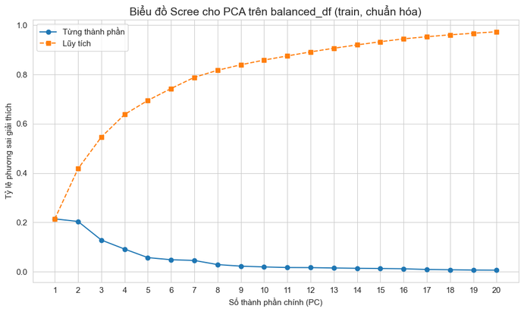
Data Evaluation Using Charts
Before Balancing:
After Balancing:
first cloud journey
12

Slide 14
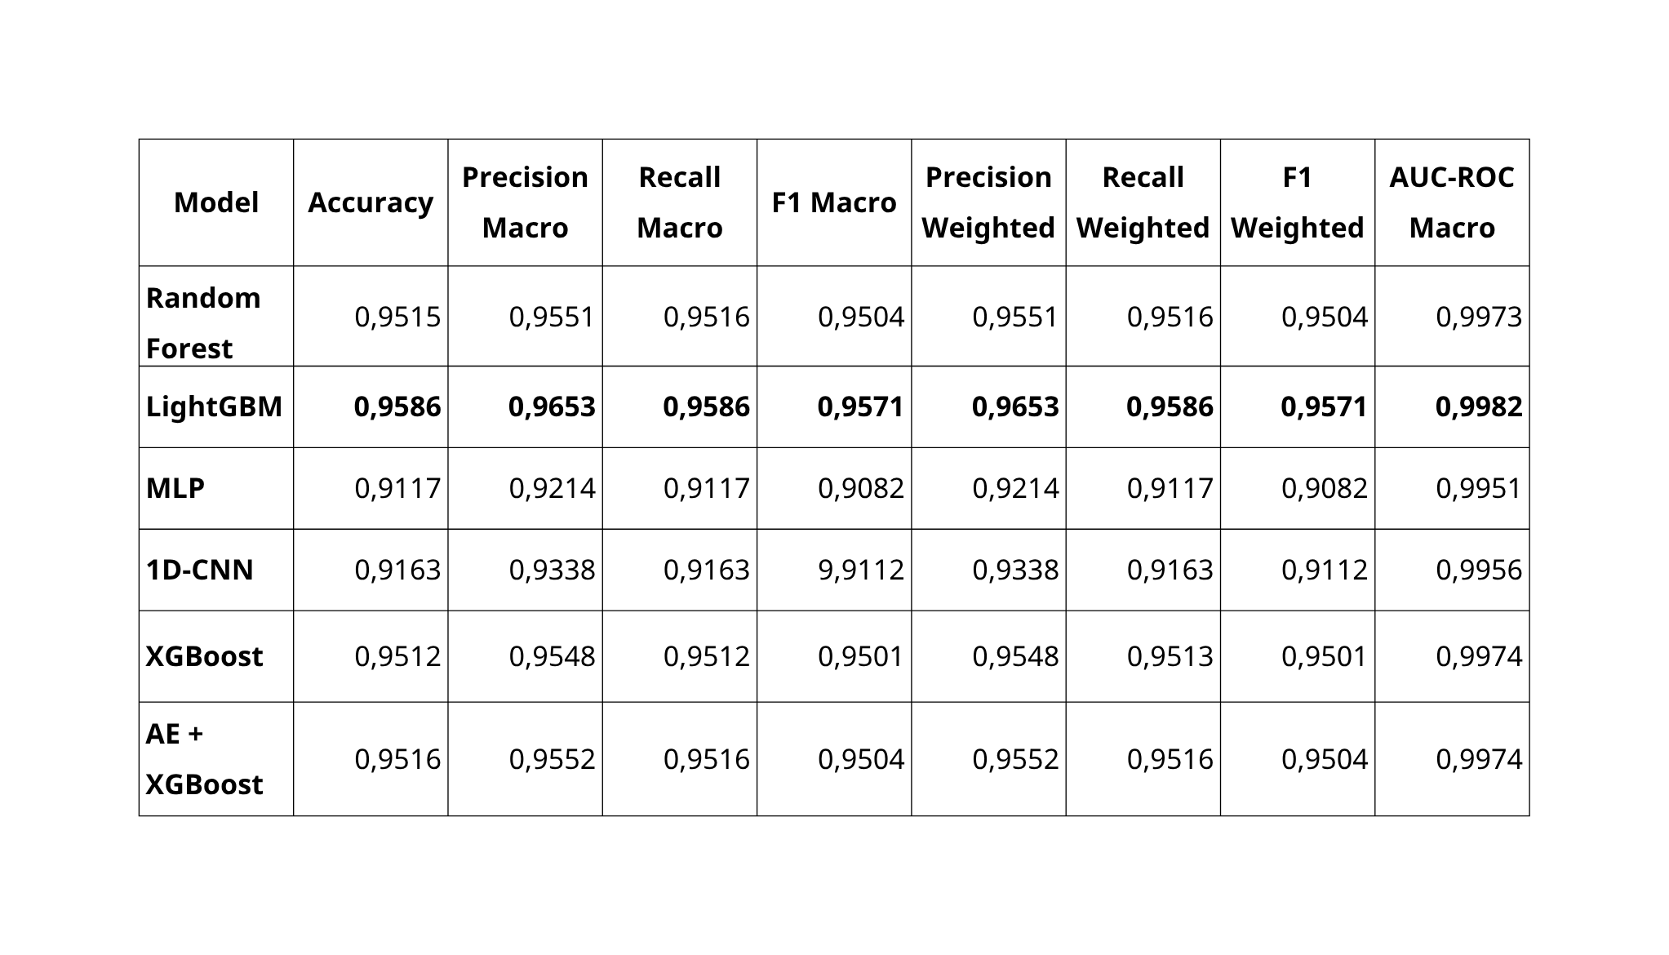
first cloud journey
13

Slide 15
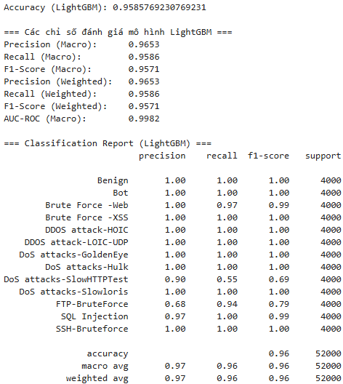
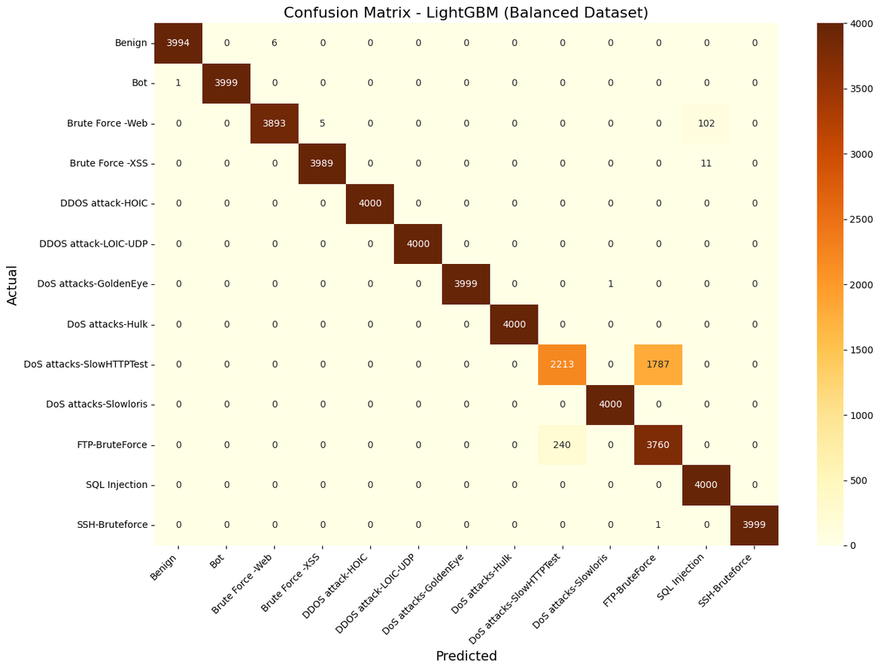
Confusion Matrix - LightGBM
first cloud journey
14

Slide 16
System architecture, AWS deployment, and operational workflow
first cloud journey
15

Slide 17
How NIDS Works
Internet
Alert
Attack
Machine Learning Model
Dataset
DASHBOARD
NETWORK INTRUSION DETECTION SYSTEM (NIDS)
Web traffic
Website
Web Server
Database
Computer
first cloud journey
16

Slide 18
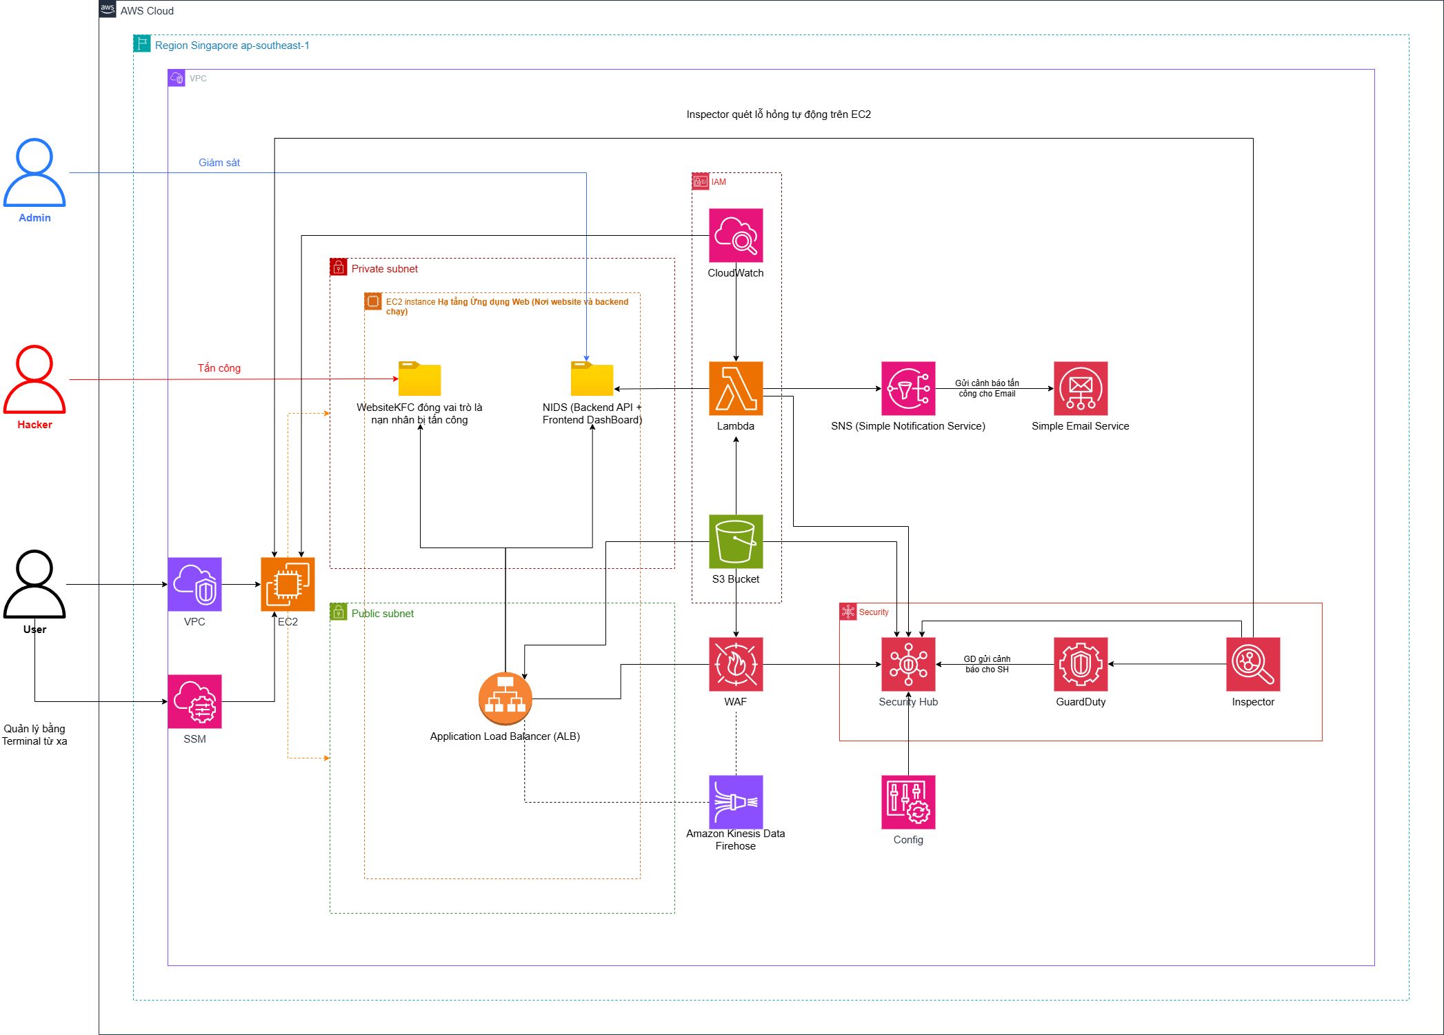
System Architecture with AWS Services
AWS Virtual Private Cloud
Amazon EC2
Application Load Balancer
AWS WAF
Amazon S3
Amazon Kinesis Data Firehose
AWS Lambda
AWS Security Hub
Amazon Guard Duty
Amazon Inspector
Amazon SNS
AWS IAM
AWS Config
AWS CloudWatch
AWS SMM
17

Slide 20
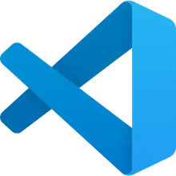
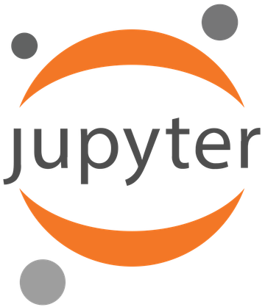
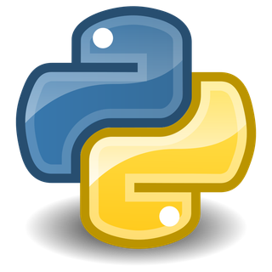


Tools and Development Environment
Tools Used
Visual Studio Code (VS Code): Used for backend and frontend system development.
Jupyter Notebook: Used for data preprocessing, analysis, and machine learning model training.
Python: Main programming language, utilizing libraries such as scikit-learn, pandas, and NumPy.
GitHub: Used for source code management, version control, and referencing open-source implementations from other developers.
AWS (Amazon Web Services): Provides cloud services for infrastructure deployment, storage, computing, and system management.
first cloud journey
18

Slide 21
Demo
first cloud journey
19

Slide 22
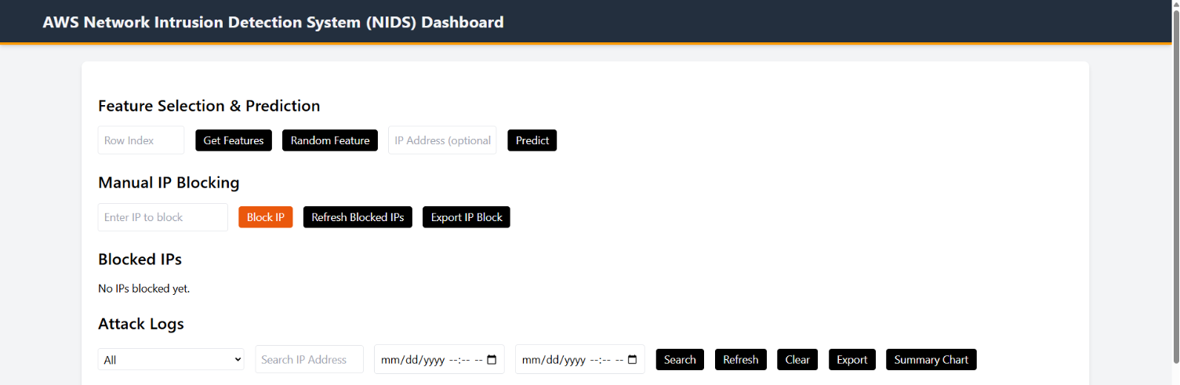
first cloud journey
20

Slide 23
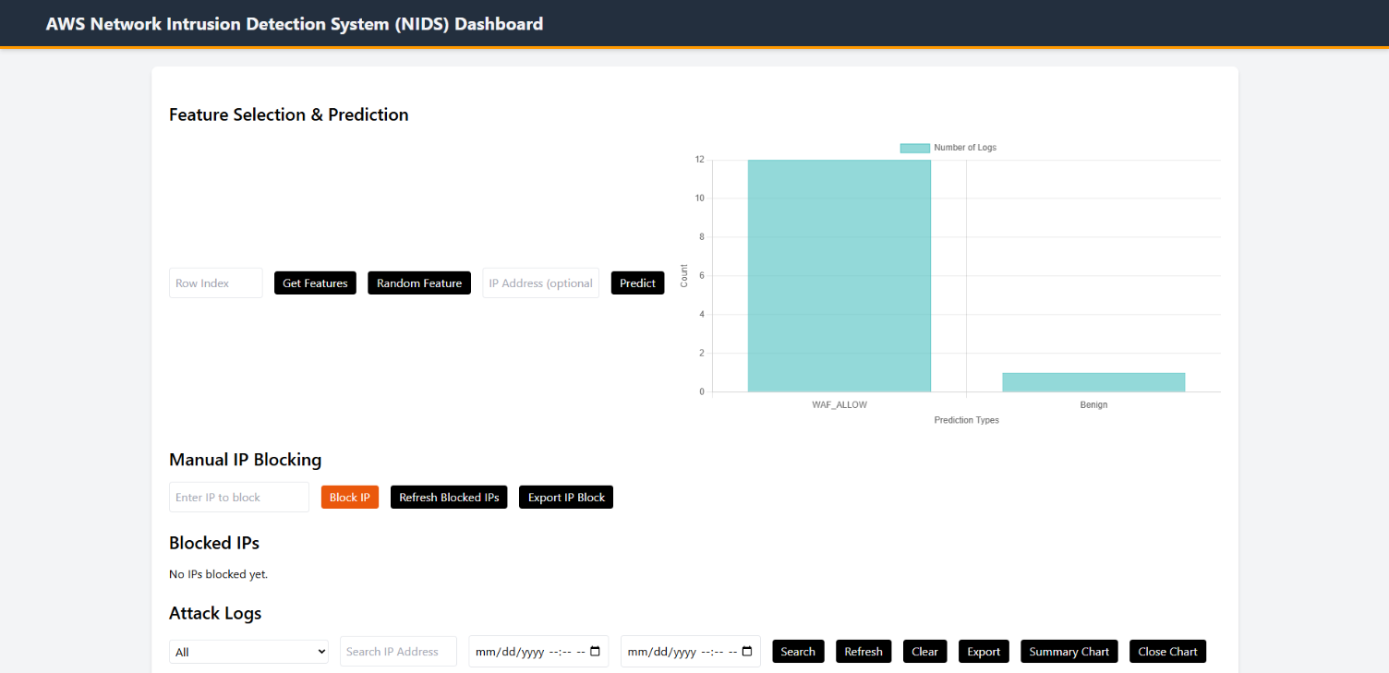
first cloud journey
21

Slide 24
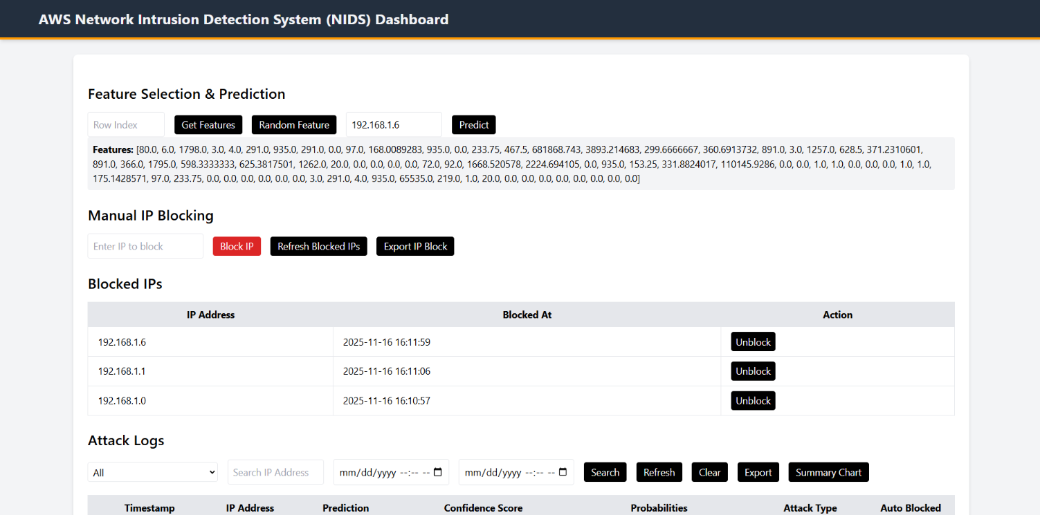
first cloud journey
22

Slide 25
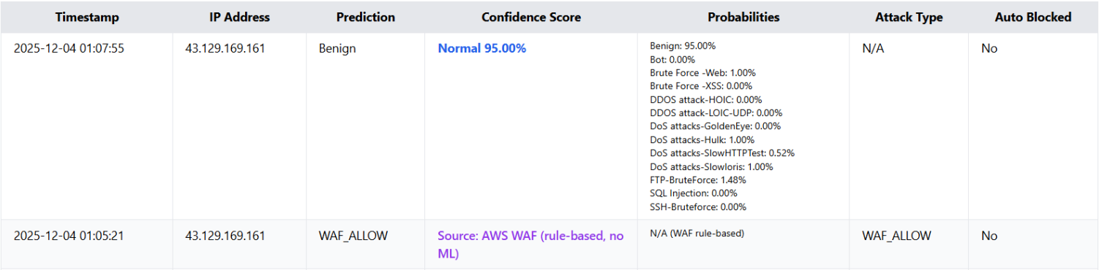
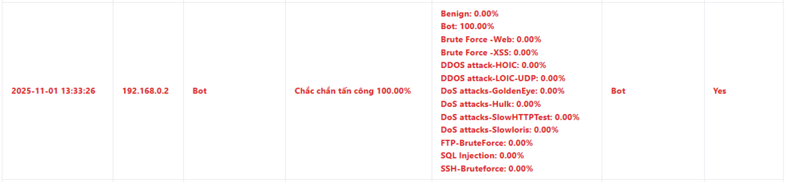
first cloud journey
23

Slide 26
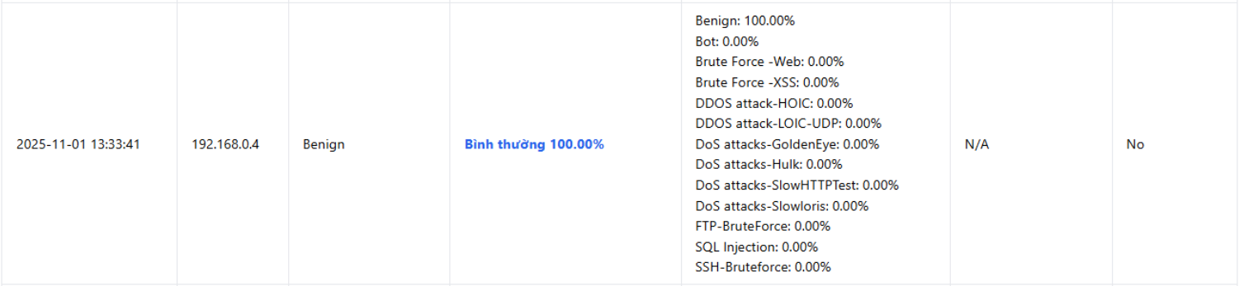
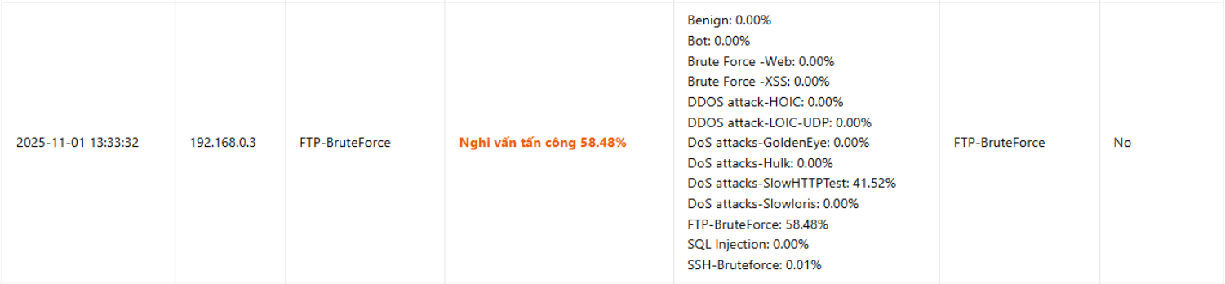
first cloud journey
24

Slide 27

Results
Optimized the machine learning model.
Addressed data imbalance issues, improving the detection of minority attack classes.
Standardized the cloud infrastructure.
Improved system management through a more intuitive administration interface.
Future Improvements
Integrate real-world data streams.
Incorporate GenAI capabilities using Amazon Bedrock.
Automate incident response and mitigation actions.
Lessons learned
Data quality is critical for ML performance.
Handling class imbalance improves minority attack detection.
Signature-based protection alone is insufficient.
ML-based NIDS complements AWS WAF effectively.
Real-time monitoring enhances threat visibility.
Cloud-native deployment improves scalability and manageability.
Continuous model updates are necessary to adapt to evolving threats.
first cloud journey
25

Slide 28

About me
Lê Hoàng Gia Đại - Pretty Boy
Become an AWS Cloud Engineer & Cyber Security Engineer
Final-year student at HUTECH University
Joined FCJ to become the CHAMPION
...
first cloud journey
26

Slide 29
Thanks for everthing
first cloud journey
27

